Slide 1
Capstone project
TMDB Movie Data Analysis
Name: Nishanthi.A
Mentor : Jaya Pandey
Batch: DA22S2

Slide 2
Introduction
Analyse the movies that cost over $100 million can still fail.
A production company wants to analyse the movie data to identify what kind of movies well perform in the cinemas and which genres they belongs to.
It will help the company predict if a movie will be in commercial success, if the movie will be highly rated.

Slide 3
Objective
Analyse a movie data to perform exploratory data analysis.
Retrieve and explore a movie dataset containing relevant information such as movie title, genres, production companies, budget, revenue and runtime.
Determine the key factors that contribute to a movie’s success.

Slide 4
Description of TMDB dataset
The TMDB(Movie Dataset) is provides information and data related to movies, TV shows and entertainment shows.
The TMDB Movie dataset contains 4803 rows and 20 columns.
There are total 13 categorical and 7 numerical columns present in the data.
For my analysis, I have considered the columns like genres, budget, title, production companies, revenue and runtime.
I used python libraries like pandas, seaborn and matplotlib.

Slide 5
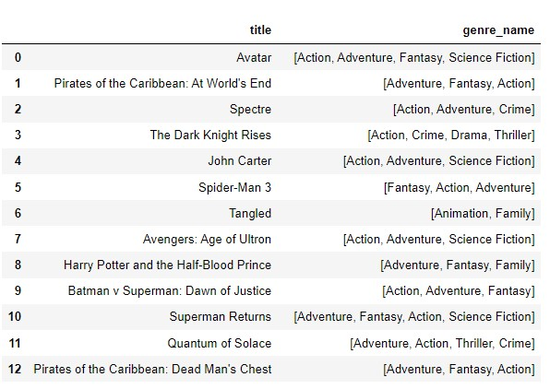
Task-1: Load the movie dataset in the Python notebook. Display the numbers of rows and columns in the dataset. Display the titles and genres of the first 50 movies from the dataset
Technique:
Output:
pd.read_csv()
df.shape
json.loads
lambda
loc()
Conclusion:
The dataset contains 4803 rows and 20 columns.
Using loc() function, I displayed the first 50 rows of title and genres.

Slide 6
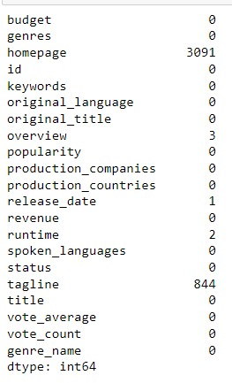
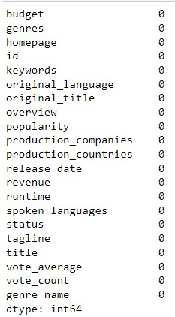
Task-2: Identify the columns that have null values and perform the null value treatment. (Choose the
imputation method based on the type of data in the columns of interest)
Technique:
Output:
df.isnull().sum()
Imputation method using fillna()
Conclusion:
The dataset contains null values in homepage, overview, release date, runtime and tagline columns.
Categorical columns treated with mode value and numerical columns treated with mean value.

Slide 7
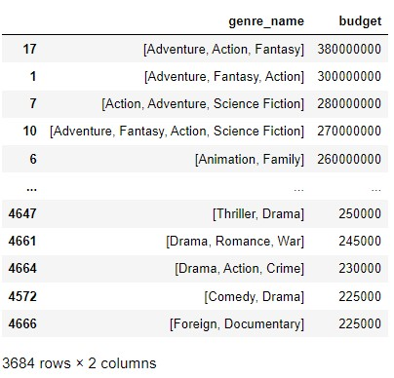
Task-3: Display the movie categories that have a budget greater than $220,000.
Technique:
Output:
Filter condition (>220000)
sort_values(ascending=False)
Conclusion:
There are 3684 movie categories that have budget greater than $220,000
Mostly action, science fiction and adventure category of movies have the highest budget.

Slide 8
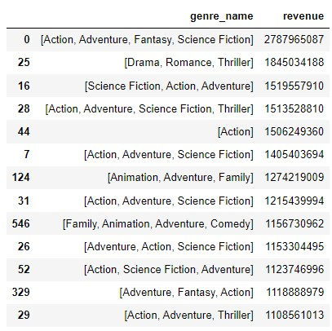
Task-4: Display the movie categories where the revenue is greater than $961,000,000..
Technique:
Output:
Filter condition (>961000000)
sort_values(ascending=False)
Conclusion:
There are 24 movie categories that have revenue greater than $961,000,000.
Mostly action, science fiction and adventure category of movies have the highest revenue same as budget.

Slide 9
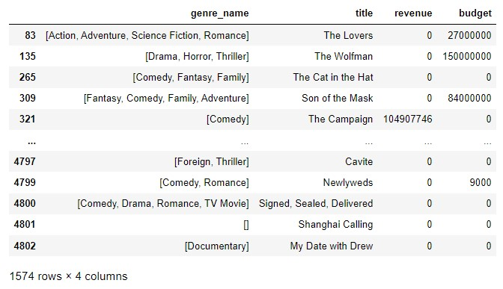
Task-5: In the dataset, there are some movies for which the budget and revenue columns have the value 0, which mean unknown values. Remove the rows with value 0 from both the budget and revenue columns.
Technique:
Output:
Filter condition
df[(df.budget==0) | (df.revenue==0)]
drop(df_name,inplace=True)
Conclusion:
Totally, there are 1574 movies having value 0 in budget and revenue columns.
For further analysis, I have considered only 3229 rows.

Slide 10
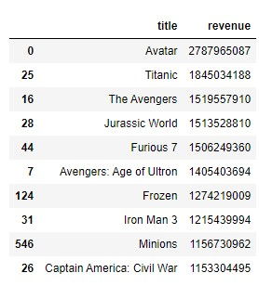
Task-6(i): List the top 10 movies with the highest revenues.
Technique:
Output:
.sort_values(ascending=False)
df.head(10)
Conclusion:
‘Avatar’ movie has the highest revenue and ‘Captain America: Civil War’ movie has the lowest revenue among these top 10 revenue movies.

Slide 11
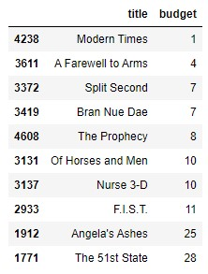
Task-6(ii): List the top 10 movies with the least budget.
Technique:
Output:
.sort_values(ascending=True)
df.head(10)
Conclusion:
‘Modern Times’ movie has the lowest budget with $1 and ‘The 51st State’ movie has the highest budget with $28 among these top 10 least budget movies.

Slide 12
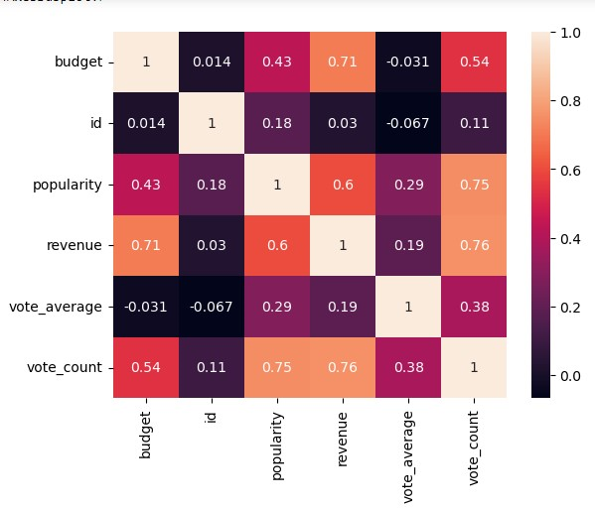
Task-7: How are popularities of movies related with the movie budgets? Are they correlated or totally uncorrelated with each other? Write the interpretation of your analysis.
Technique:
Output:
Filter condition
df[‘budget’].corr(df[‘popularity’])
sns.heatmap()
Conclusion:
Popularity and budget columns having positive correlation with the value 0.43.So, if budget increases then popularity will also increases.

Slide 13
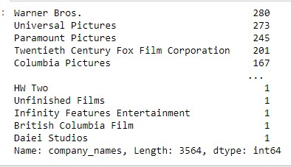
Task-8: Identify and display the names of all production companies along with the number of times they appear in the dataset.
Technique:
Output:
json.loads
lambda
.explode()
.value_counts(sort=True)
Conclusion:
The production company ‘Warner Bros’ has appeared 280 times.

Slide 14
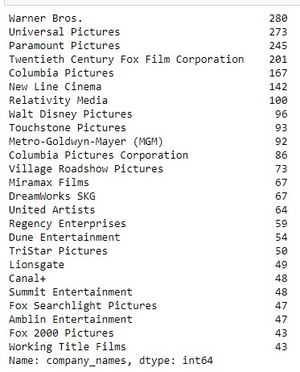
Task-9: Display the names of the top 25 production companies based on the number of movies they have produced in descending order of the number of movies produced
Technique:
Output:
df.head(25)
Conclusion:
The production company ‘Warner Bros’ has appeared 280 times and second highest is ‘Universal Pictures’ appeared 273 times.

Slide 15
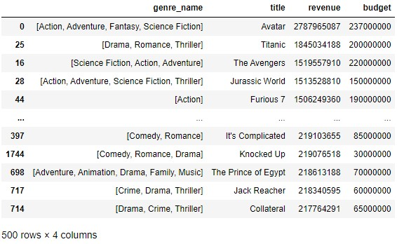
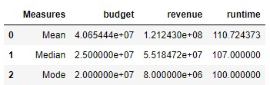
Task-10: Sort the data in descending order based on revenue and filter the top 500 movies. Find the measures of central tendency for the following columns using the filtered data:
1. budget 2. revenue 3. runtime
Technique:
Output:
.sort_values()
.head(500)
Mean(),Median(),mode()
sns.boxplot
Conclusion:
‘Avatar’ movie generated highest revenue but the budget is lower than revenue.
Runtime of ‘Avatar’ movie is 162 minutes.

Slide 16
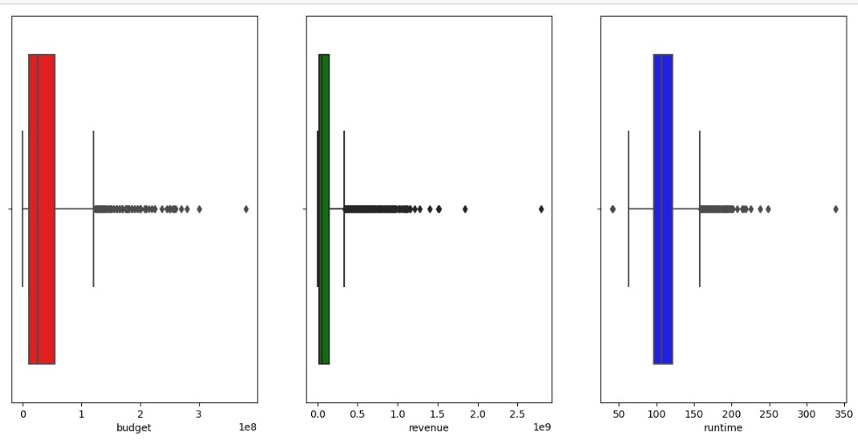
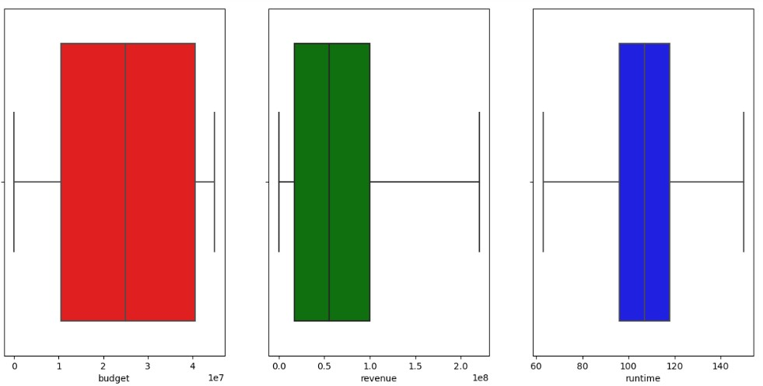
Perform outlier analysis for the above three columns using box plots.

Slide 17
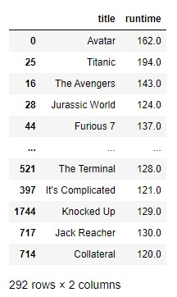
Task - 11: Identify and display the names of the movies along with their run times for those movies that have above average runtime, using the data from the previous task.
Technique:
Output:
.mean()
Filter condition
Conclusion:
There are total 292 movies which has runtime greater than the average runtime.
‘Gone with the wind’ movie has the highest runtime with 238 minutes.

Slide 18
Conclusion
‘Action, Adventure, Fantasy and Science Fiction’ are the most profitable genres.
‘Drama and Comedy’ are the most popular genres.
‘Avatar’ and ‘Titanic’ movies are generated highest revenue and they have less budget than revenue.
‘Modern Times’ is the very least budget movie with $1.
There is positive correlation between ‘budget’ and ‘popularity’ with 0.43
Also vote_count is positively correlated with popularity(0.75) and revenue(0.76)
‘Warner Bros’ and ‘Universal Pictures’ are the very famous production companies because they produced high number of movies.
The average runtime of the movies is 110 minutes.There are 292 movies have runtime greater than average runtime.

Slide 19
Thank You

